Slide 1

Text Summarization and Questionnaire Generation using Deep Learning
CS 692 Capstone Project 2
Group Members:
Helee Rana(U01681431)
Jasmeet Kaur Ubhi (U01664194)
Karandeep Singh Multani (U01641217)
Rhea Rai (U01736934)
Shreyas Damle (U01632231)

Slide 2
Introduction:
Base Idea: Text Summarization, Questionnaire & Answer Generation.
Motive: Our team created a system in which people can do smartwork by using our application which minimize their hard work of reading bulky text.
Improvement: This time we have implemented a additional feature of ‘Voice Assistant’ which can help more people to rely on our application, Also we have improved the interactivity of our application which makes it more user friendly and easy to use.

Slide 3
User story

Slide 4
User story

Slide 5
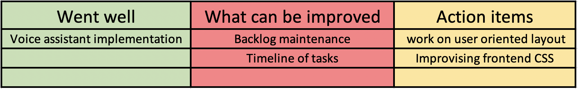
Retrospective

Slide 6
Voice Assistant
Voice Assistants are bots which react to voice commands given by a user and serve the user by returning relevant information in the form of voice.
Use in Our Application: -
We have implemented an additional feature of voice assistant which shows current time, finds our location, searches on google and wikipedia.

Slide 7
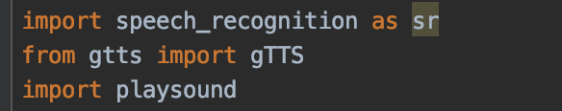
Technology Used
speech recognition library in Python
Google's text-to-speech API. (gTTS)
playsound

Slide 10
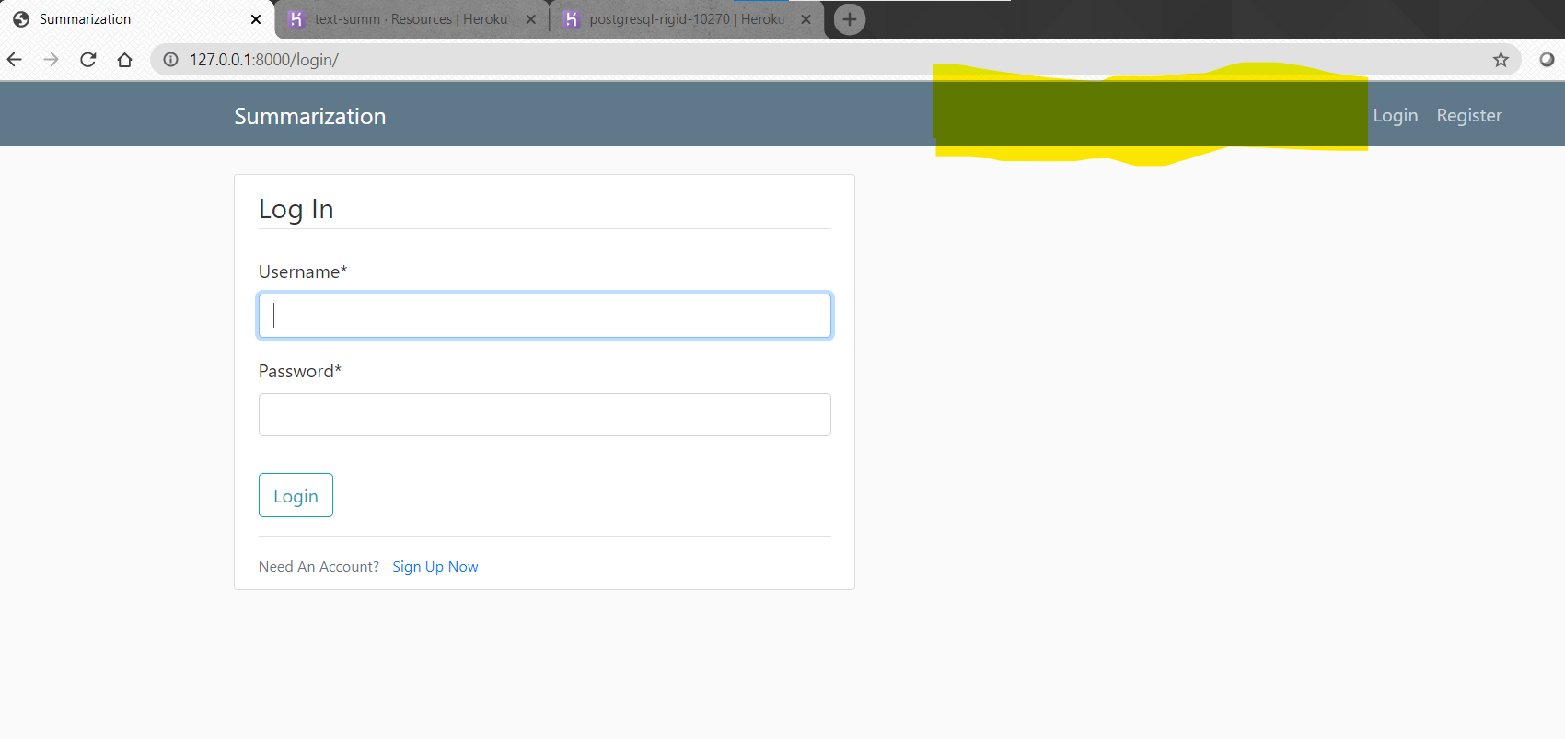
Login Session:

Slide 11
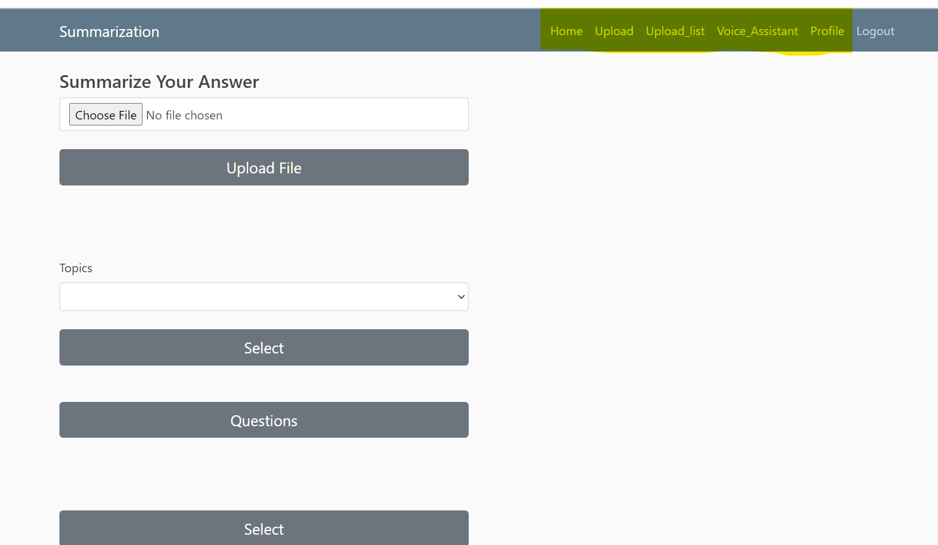
User Session:

Slide 12
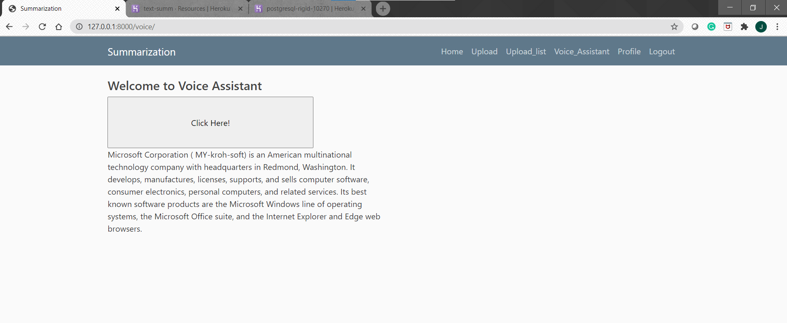
Voice Assistant:

Slide 13
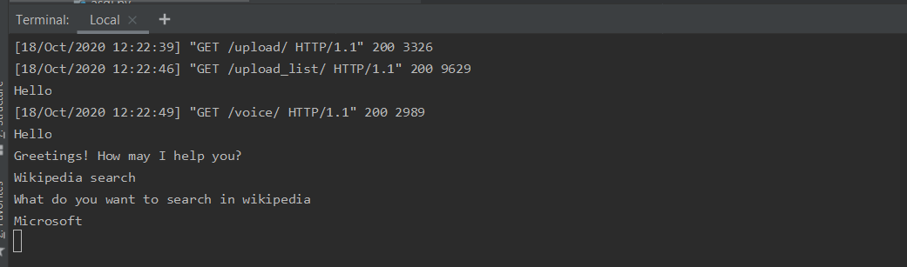
Voice Assistant:

Slide 14
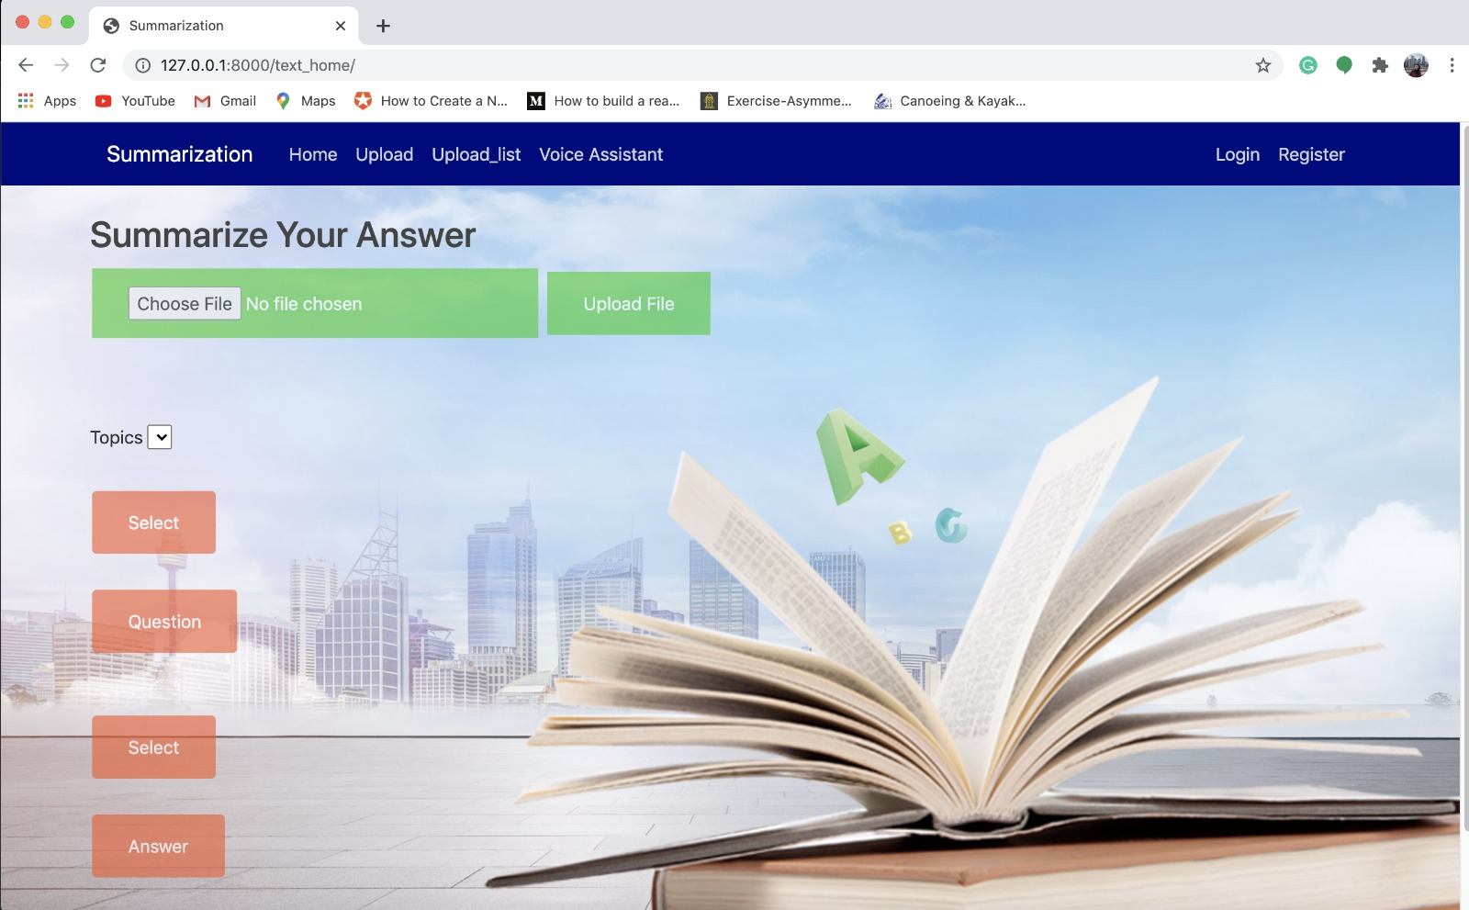
CSS:

Slide 15
Github link:
https://github.com/Jassubhi/text-summarization-project/wiki/Text-Summarization-and-Questionnaire-Generation-using-Deep-Learning

Slide 16
Thank You.

